Slide 1
Waterway-sunrise-ii_654C

Slide 2
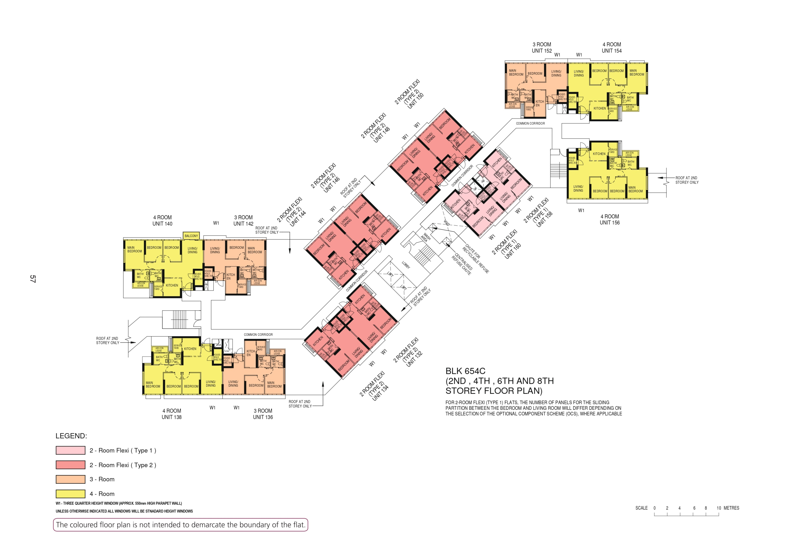

Slide 3
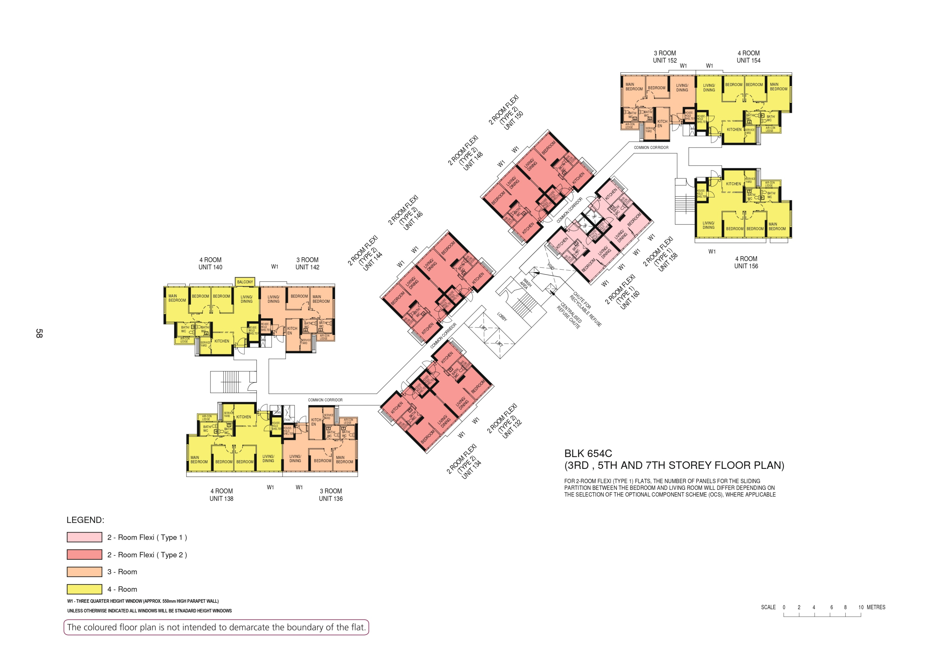

Slide 4
138
136
COMMON CORRIDOR
150
148
COMMON CORRIDOR
156
158
160
146
140
142
144
LOBBY
WASH
AREA
COMMON CORRIDOR
132
COMMON CORRIDOR
134
138
136

